Slide 1
Girls Who Code
Helping GWC to Connect Volunteers to Girls Who Code Everywhere
Team BADMM
Brent Thompson Ajith Punnakula
Dave Green
Melanie Steck
Mackenzie Jackson

Slide 2

How does the GWC process work today?
Distributes info on how to volunteer
Connects Club Org to Corporate Club
GWC
Organize volunteers to teach Girls
Corp.
Partners
Curricula Begins
Reads list and sets up GWC club
Report Status on Girls who want to code
Club Orgs.

Slide 3
The current state of GWC is inefficient and full of pain points for the parties involved
X
Information on volunteer opportunities is static and difficult to consume
Limited metrics to track engagement of Corporate Partners
X
RM: Inefficiencies in organizing volunteers – mainly email
RM: Unable to understand when Club Orgs are ready to receive help
X
Difficulty understanding how to engage GWC
Unable to inform Corp. Partners of current status (ready for curriculum)
VN: Difficulty planning availability to volunteer
GWC Admin
Corporate Partners
Club Organizations

Slide 4



Girls Who Code need a new way to engage their partners.
Corporate Partner Volunteers
GWC needs to enable Resource Managers and Volunteers at Corporate Partner organizations to find Club Organizations to volunteer at and manage volunteer availability
Blue Font
Red Font
Yellow Font
Green Font
Club Organizations
GWC needs a way to track which organizations have clubs and students ready to learn, and provide this information
Metrics for GWC
GWC needs to be able to track metrics regarding partner involvement
How can we help GWC achieve this functionality?

Slide 5
Girls Who Code can solve these problems with a unified portal for GWC partner engagement.

Slide 6
We used UCD and interviews with a current GWC RM at Accenture to design a bespoke app experience.
App Design Principles
Future Extensibility
Simple Implementation
Solves Pain Point
Low Cost

Slide 7
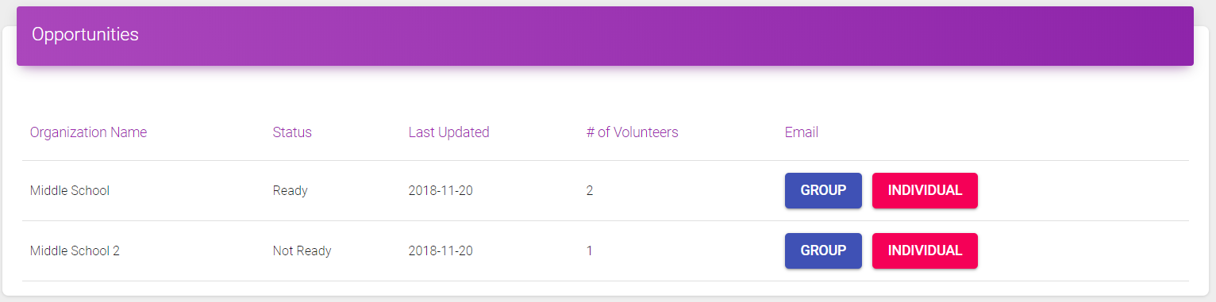
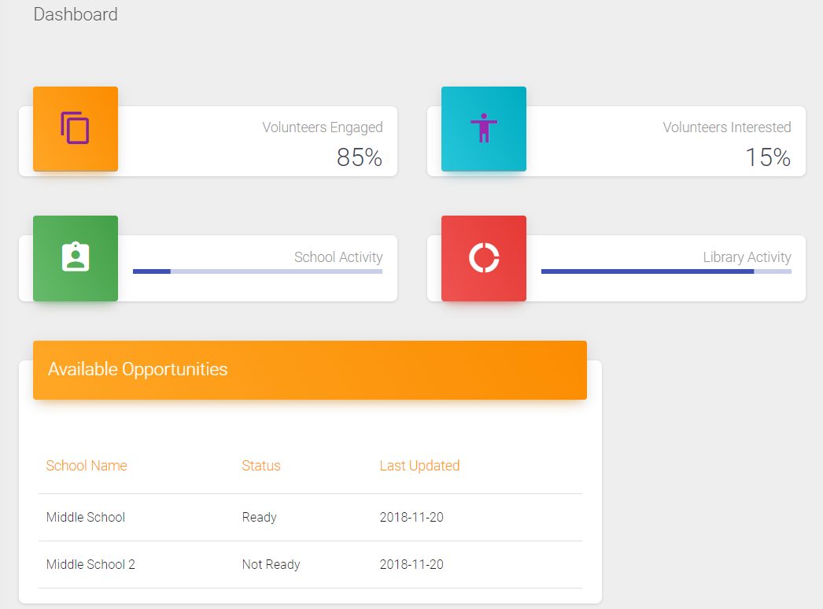
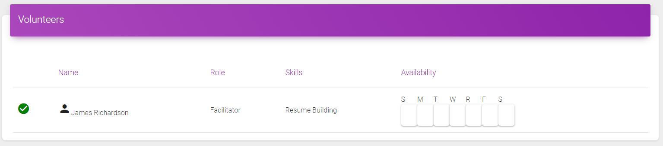
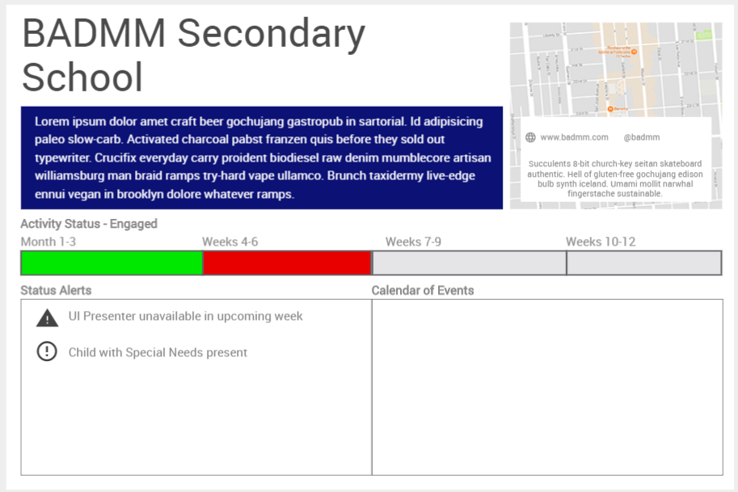
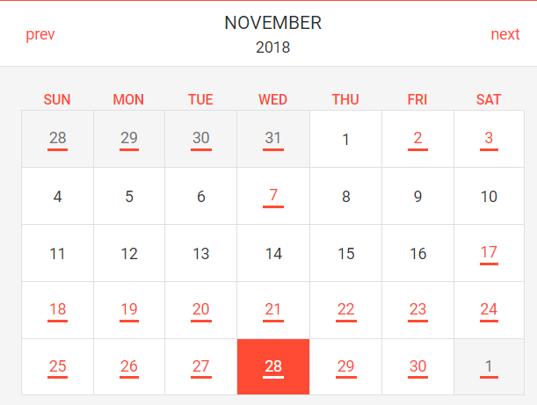
What does our unified portal look like?
Legend:
Demo
Mock-Up
Future State
GWC Admin Dashboard
Self Serve Reporting
GWC
Relationship Manager Dashboard
Opportunity List
Map View of Opportunities
Volunteer List
Corp.
Partners
Volunteer Profile
Messaging Portal
Organization Profile
Club Organization Dashboard
Club Orgs.

Slide 8





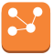








Amazon AWS Services in Use
AWS Cloud – Current State
AWS Cloud – Future State Opportunities
Region – US East
React
GitHub Repo
Amazon S3 Static Website Hosting
API Gateway
Amazon Neptune
Git Push
Git users
Python
PostgreSQL
Amazon Polly
APIs and Event Handlers
RDS PostgreSQL Database
Deployed with Docker

Slide 9
Demo – Dashboard and Opportunity List

Slide 10
Mock-up: Club Organization Profile
https://tockify.com/i/upcomingCustomizer?tab=basics

Slide 11
What are the key next steps for Girls Who Code?
30 Days
Organize Two-pizza team to continue app dev.
Implement CI/CD Pipeline to add new features
Mock-up remaining screens
MVP of all screens and functionality
60 Days
Pilot with strong user groups from Corporate Partners
Test app end-to-end
Add security features
Develop Feature plan
90 Days
Deploy to all user groups
Continuous improvement

Slide 12

What future growth opportunities are available to Girls Who Code with this Platform?
Machine Learning
Use Sagemaker to auto-assign volunteers to opportunities based on role, skill, and availability
Volunteer Geographic Proximity Search
Use Graph Database to enable geographic search for Volunteer proximity to opportunity
Automated Messaging
Implement a Chatbot to confirm status of Club Org readiness to accept volunteers
Amazon Neptune
Amazon Polly

Slide 13
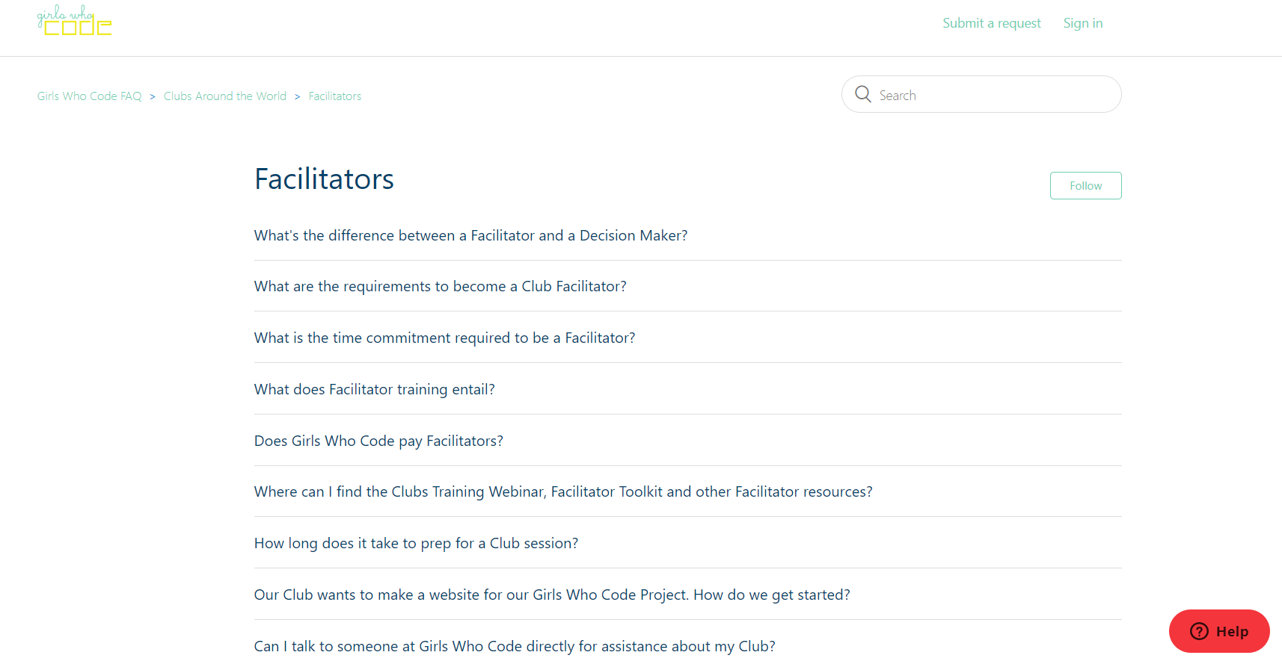
FORMATTING
Blue Font
Red Font
Yellow Font
Green Font

